Slide 1
Python Fact!!
Python was not named after a snake.
It was named after a famous
Comedy shows on BBC
“Monty Python’s Flying Circus”
Source:- “Trust me bro.”
Oh I mean “docs.python.org”

Slide 2
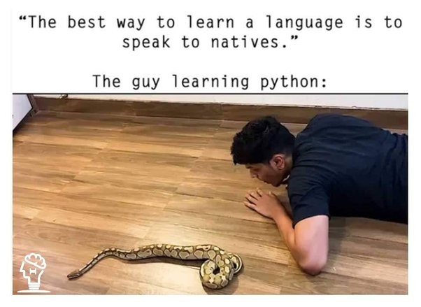

Slide 3
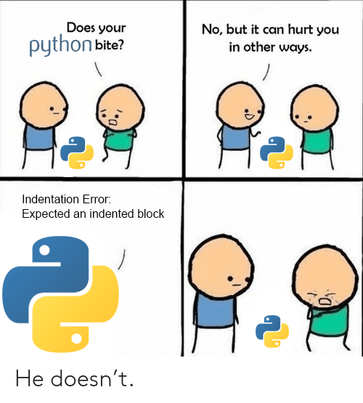

Slide 4
Python Fact!!
Python has different Variant:
CPython
Jython
IronPython
Brython
RubyPython
PyPy
MicroPython

Slide 5
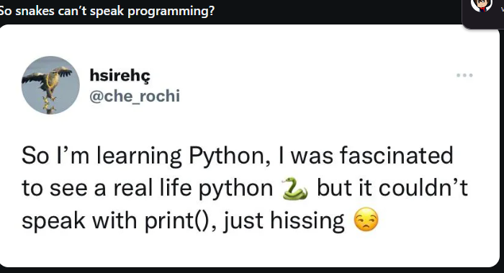

Slide 6
Python Fact!!
3. Python Has One of the Largest Community Support
Python has one of the largest community support systems in the programming world. The vast network of Python users consists of people from various platforms. There are many online tutorials, notes, and resources available for free. It makes it easier for new programmers to learn from the best resources.
The vast community also offers help whenever someone is struggling with doubt. They also contribute to open-source projects. This extensive support makes sure that people everywhere can find proper assistance, share ideas, and collaborate openly on projects.

